Slide 1
An Untitled Mining Game
Notes:
Capstone project
Talk about, what it is, how I made it (process + tools), then demo

Slide 2

Overview
What is “An Untitled Mining Game”?

Slide 3
Overview
Inspired by Idle Games (AdVenture Capitalist, Cookie Clicker, etc.)
Encourage Active Engagement, Idle is a Bad Word®
Incremental Game, Big numbers go WOOSH
Designed around core “Mine, Refine, Upgrade”

Slide 4
Technologies used
What did I use to create “An Untitled Mining Game”?

Slide 5

Technologies Used
Game Maker Studio 2, GML
Why GMS over tools like Unity?
Worthwhile Experience?
Asset Creation and Credits

Slide 6
Development Process
Yeah, but like, how did I create “An Untitled Mining Game”?

Slide 7
Systems Driven Agile Development
Function First, Fix it Later
Rapid creation, feedback, and implementation
Forward thinking and dynamic, but you can always refactor later
Decomposition and specifics (Nodes, Structs, Zones)

Slide 8
Testing
What did others think of “An Untitled Mining Game”?

Slide 9
Two Types of Tests
Ad-Hoc
End-to-End
Loosely Directed
Game Feel
General feedback and how to move forward (direction, movement, feedback and labels)
Very Specific
Targeted Systems
Fixing what doesn’t work (mouse level, dynamic input + static output)

Slide 10
Lessons Learned
GML is very picky
DELETE COMPLEX DATA STRUCTURES, YOU WILL CRASH YOUR COMPUTER
GitHub Workflow
That I never want to be a remote worker

Slide 11
Demo + Q&A
Notes:
Demo Plan:
Spawn in, wander
Mess around with inventory, highlighting picking up and letting go
building structures, and show the difference between green and red
sure renown in inventory, reset, show new renown and explain what it does (mouse_levels)
load pre-built save file
illustrate the difference in structure speeds using infinite shiny
explain the mouse tool structure
talk about relics and spending renown
build shopping stall and show effects of pick power

Slide 12
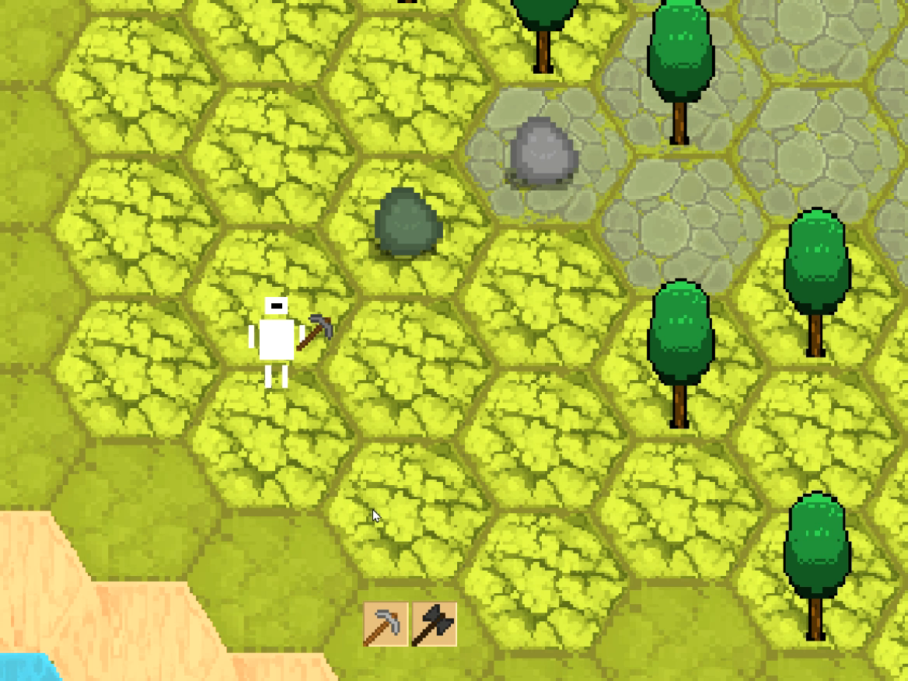
Structs
Different structs with different recipes
Struct leveling system
Buildable by the player

Slide 13
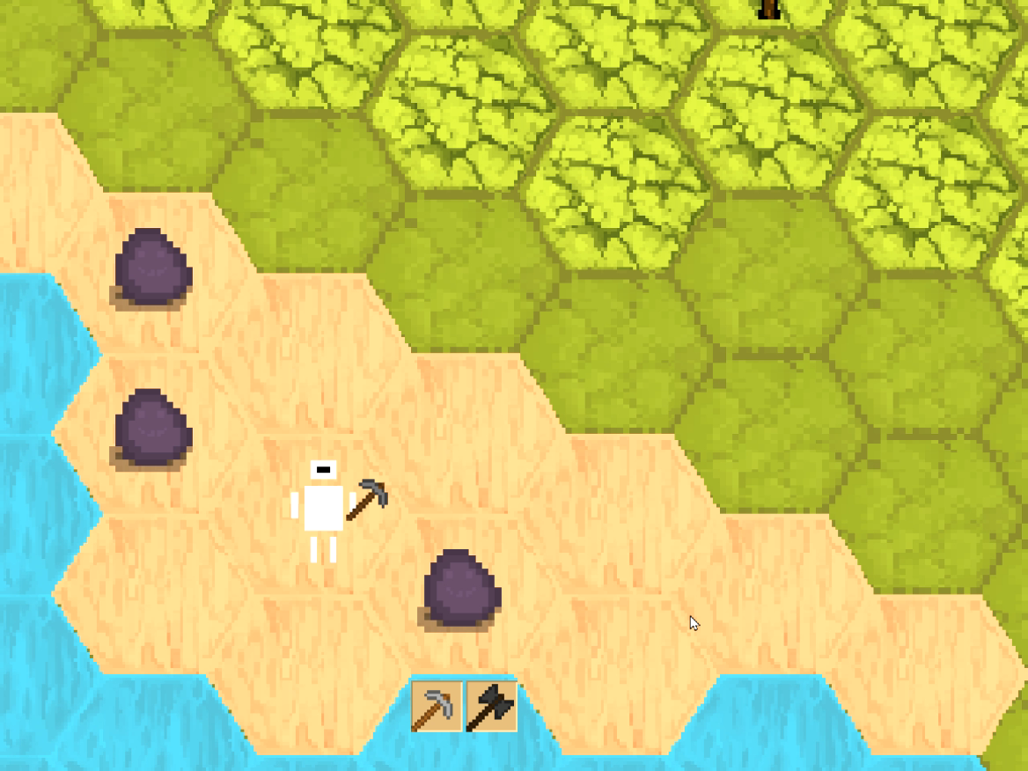
Zones
Varying spawns per region
Each region unique mat
Regions locked behind game progression
Looking forward

Slide 14
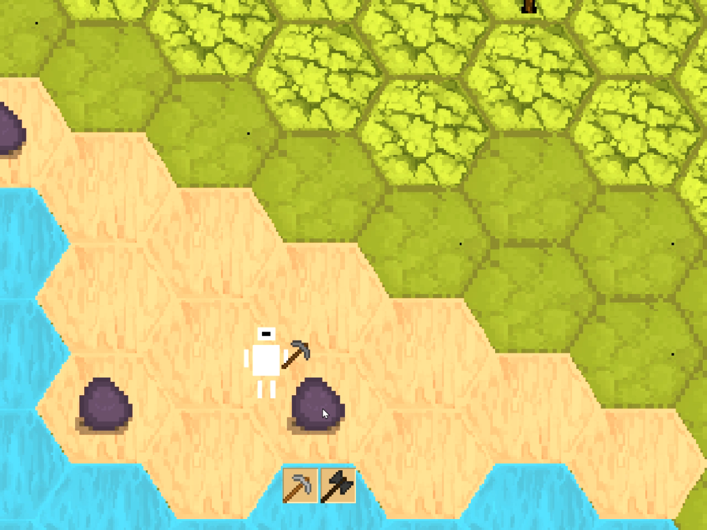
Nodes
Given health and varying drops
Controlled by Parent Object
Determined by a zone-specific spawner

